Slide 1
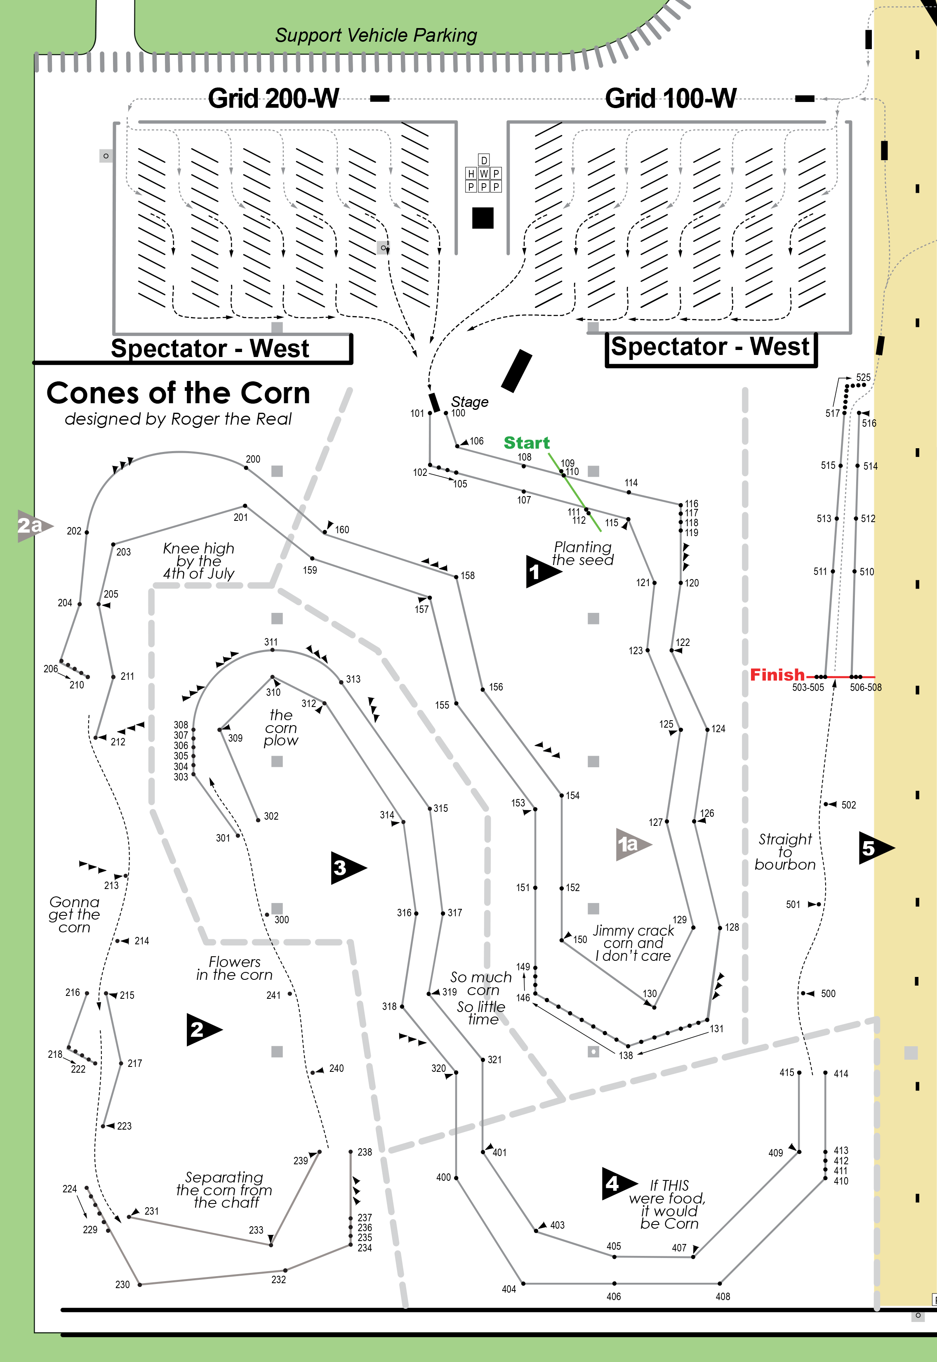
C,208,
C,111,110
C,115,
C,117,116
C,210,
C,113,
C,116,
C,118,
C,213,
C,209,208
C,207,
C,204,
C,121,
Exit,533,532
Exit,532,
C,216,
Stage,101,
Stage,100,101
C,202,
C,203,202
C,201,200
C,531,
C,530,
C,218,
C,217,218
C,102,
C,106,
C,529,
C,528,
C,105,
C,107,
Start,110,111
C,527,
C,526,
Start,111,
C,112,
C,525,
C,524,
C,219,
C,523,
C,522,
C,200,
C,521,
C,520,
C,220,
C,123,
C,122,
C,221,
C,149,150
C,517,
Finish,516,518
Finish,518,
C,519,
C,125,
C,124,
C,222,221
C,148,
C,128,
C,129,128
C,147,148
C,127,
C,126,
C,130,
C,131,130
C,515,514
C,514,
C,223,
C,300,
C,153,
C,142,
C,505,513
C,513,
C,150,
C,146,142
C,504,506
C,506,
C,318,
C,319,
C,132,
C,143,
C,141,132
C,136,
C,133,
C,301,300
C,503,500
C,500,
C,302,
C,313,312
C,501,
C,308,
C,312,
C,317,316
C,321,
C,322,
C,314,
C,316,
C,320,
C,328,320
C,425,418
C,418,
C,417,
C,329,
C,423,
C,421,
C,416,
C,330,
C,412,
C,406,
C,400,
C,419,412
C,410,
C,408,
C,407,406
C,405,400
C,404,
C,401,
C,415,
C,414,
C,411,410
C,409,408
C,413,

